Slide 1



OESON PROJECT II: ANALYZING HR DATA & TURNING IT INTO INSIGHTFUL VISUALIZATION
BY ANASS EL AQLI

Slide 2



TABLE OF CONTENTS
Introduction
Departments Visualization & Comparisons
Company Demographics Visualizations
More Highlights and Visualizations
Summary

Slide 3
INTRODUCTION
In this project, I was given HR data from an organization XYZ Technologies. I'm thrilled to share insightful visualizations derived from the company's data. Using Python's Pandas, Matplotlib, and Seaborn. Let's dive into these graphics to uncover key highlights and patterns that shape the company.
ts you.

Slide 4
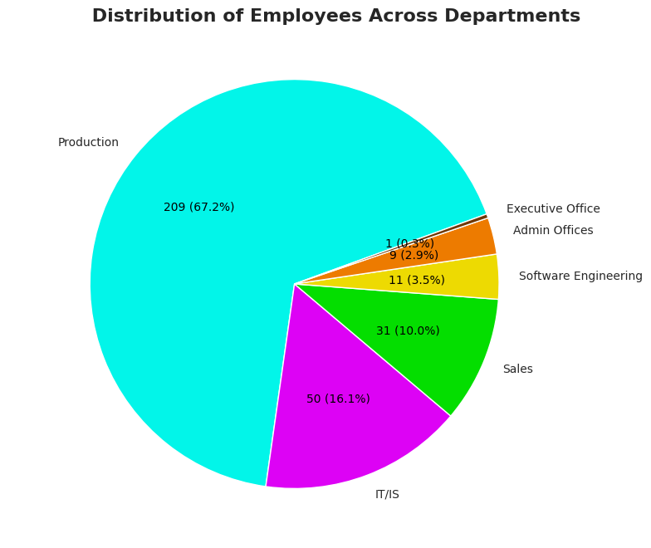
DEPARTEMENTS VISUALIZATION & COMPARISON
NUMBERS
From this pie chart we can understand that the majority of employees work in the production department.
Followed by IT/IS and Sales departments. While the Executive Office is only 1 person.

Slide 5
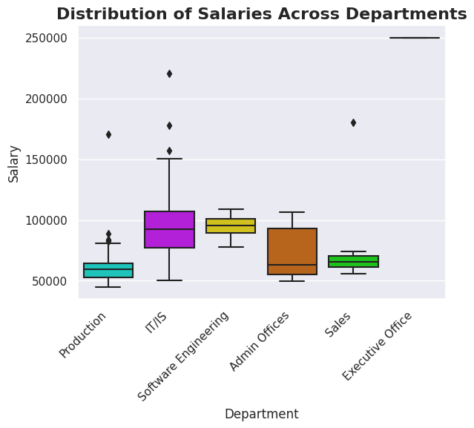
DEPARTMENTS VISUALIZATION & COMPARISON
SALARY
This box plot shows that the production department has the lowest median salary.
The highest median salary belongs to the Executive Office department (1 person), followed by the Software Engineering department.

Slide 6
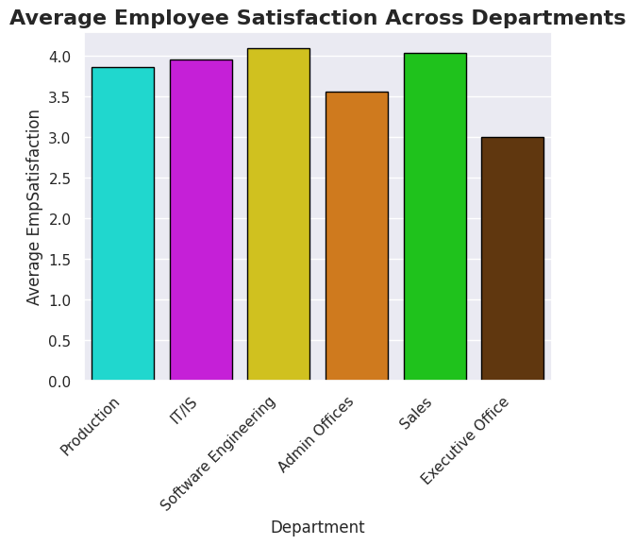
DEPARTMENTS VISUALIZATION & COMPARISON
EMPLOYEE
SATISFACTION
The bar chart illustrates that the Software Engineering department has the highest average satisfaction.
The Executive Office department has the lowest average. Followed by the Admin Offices.

Slide 7
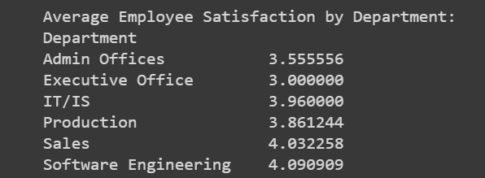
DEPARTMENTS VISUALIZATION SUMMARY
NUMBERS
SALARY
Most employees of the company are in the production departement (67.2%)
EMPLYEE SATISFACTION
However, production employees earn on average less than any other department.
The 1 person in the Executive Office earns the highest salary. and the Department of Software Engineers has people who earn the most on average.
We can see that the CEO and the people in the Admin Offices aren’t that satisfied. While software engineers are the most satisfied on average.

Slide 8
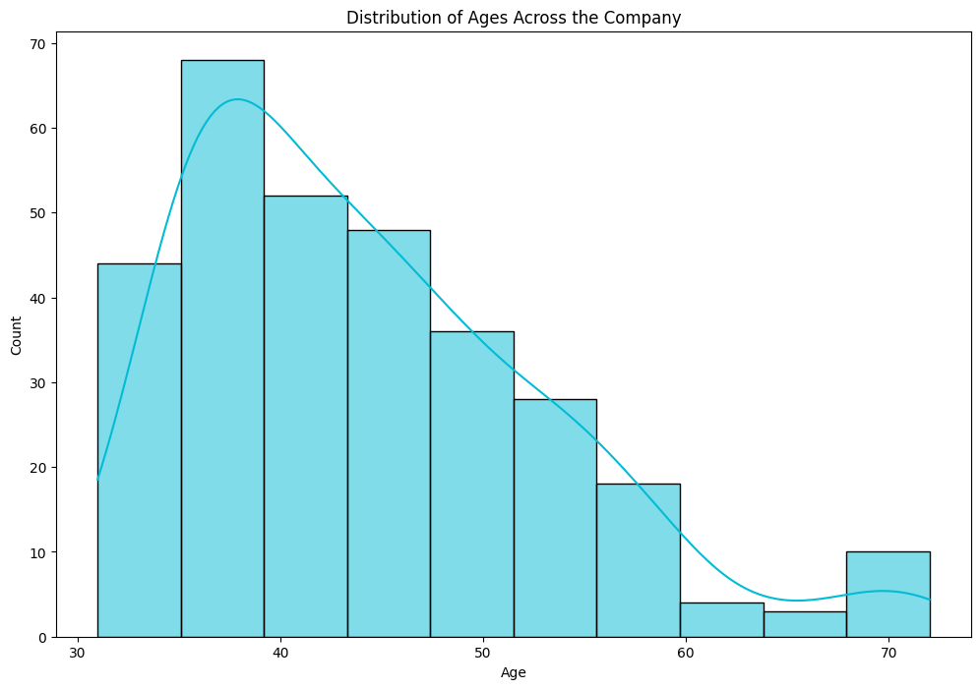
COMPANY DEMOGRAPHICS
AGE
We can observe that the majority of employees in this company are between the ages of 30 and 50, with the highest number of employees being in their late 30s.

Slide 9
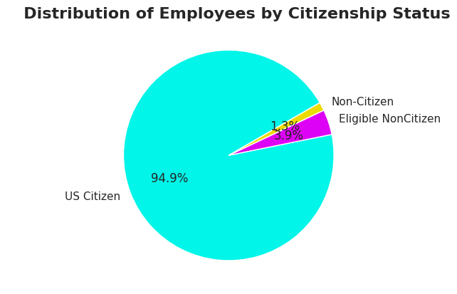
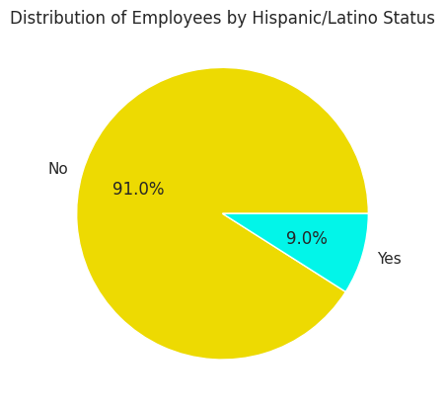
COMPANY DEMOGRAPHICS
CITIZENSHIP
The workforce of the company is predominantly American citizens.
With 9% of the employees having a Hispanic/Latino background.

Slide 10
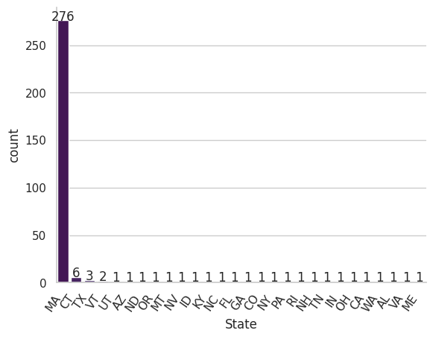
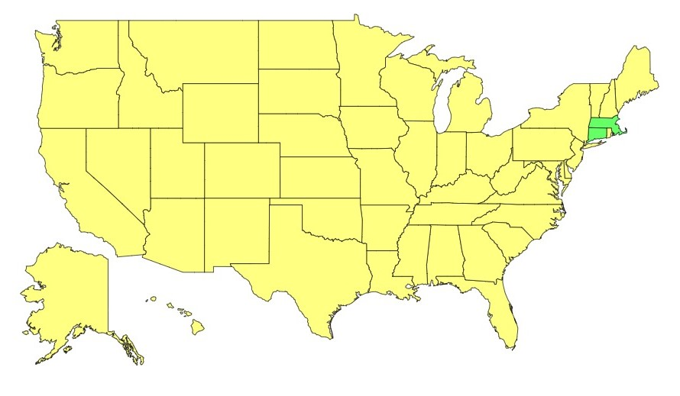
COMPANY DEMOGRAPHICS
More than 90% of the employees are from here
STATE
Not only are almost 95% of the employees American, but they’re also mainly from the state of Massachusetts (88.75%) and around 2% from its neighbor, Connecticut.
This map is from: jetpunk.com

Slide 11
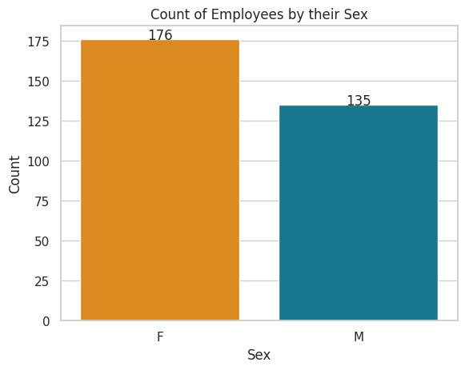
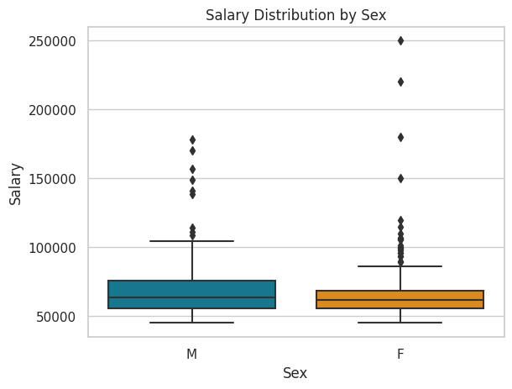
COMPANY DEMOGRAPHICS
COMPARISON BY SEX
The count plot demonstrates that there are more females than males in this company.
However, the box plot shows that females earn slightly less on average than their male counterparts. with outliers such as the female CEO who earns $250,000.

Slide 12
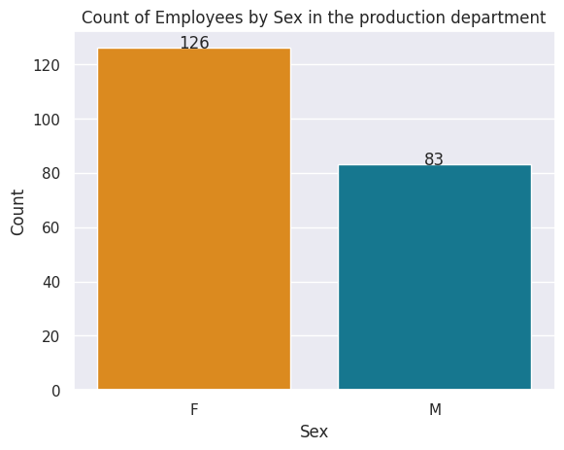
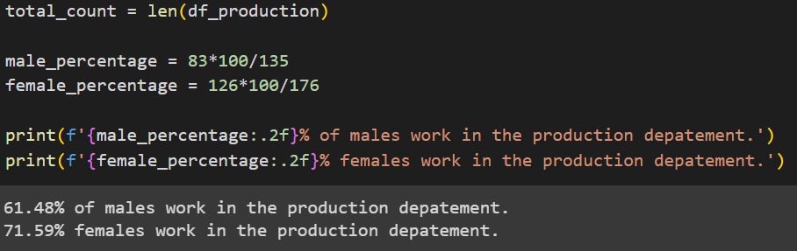
COMPANY DEMOGRAPHICS
COMPARISON BY SEX
Unfortunately, the dataset does not encompass the multitude of reasons contributing to the gender pay gap.
However, one observable factor I would assume based on the data is that 71.59% of females are employed in the production department, which is associated with lower salaries, compared to 61.48% of males.

Slide 13
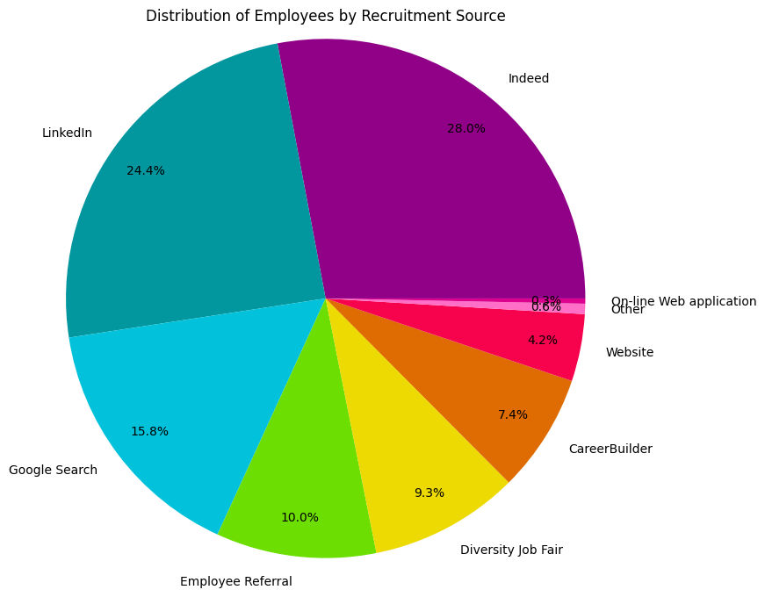
COMPANY DEMOGRAPHICS
RECRUITMENT SOURCE
More than half of the employees were recruited from Indeed and LinkedIn.
Other significant sources are Google Search, referrals, and Diversity job fairs.

Slide 14
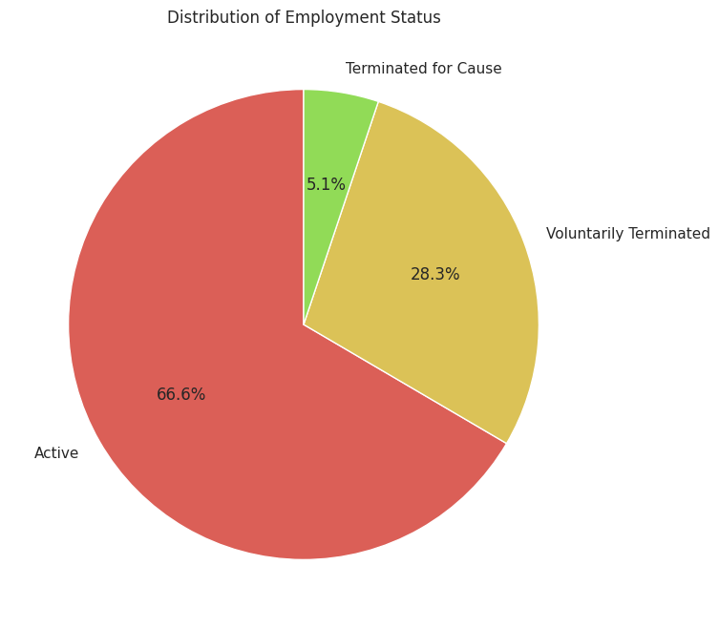
COMPANY DEMOGRAPHICS
EMPLOYEE STATUS
66.6% of the employees still work in the company. While 33.4% have a terminated status mainly voluntarily.

Slide 15
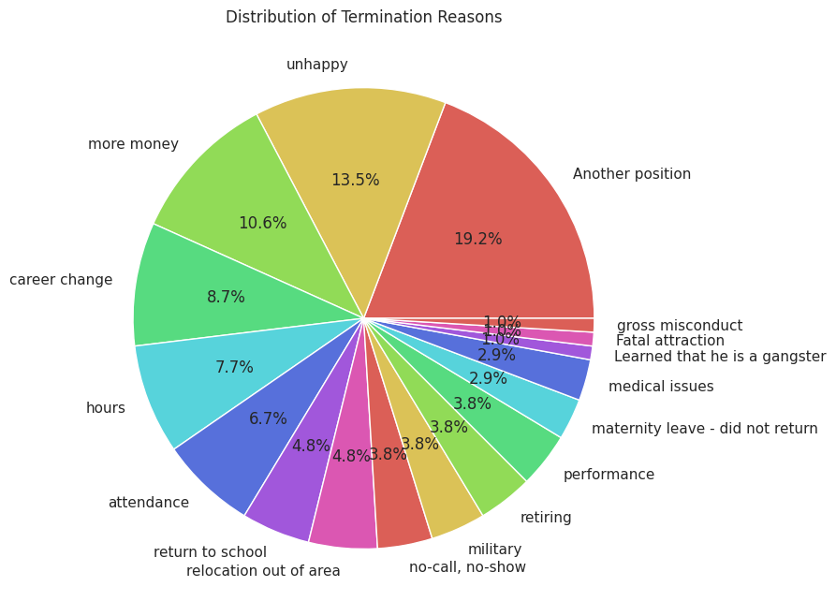
COMPANY DEMOGRAPHICS
EMPLOYEE STATUS
The employees with terminated status left for multiple different reasons with the most common ones being leaving for another position, followed by unhappiness, wanting more money, career change, and more.

Slide 16
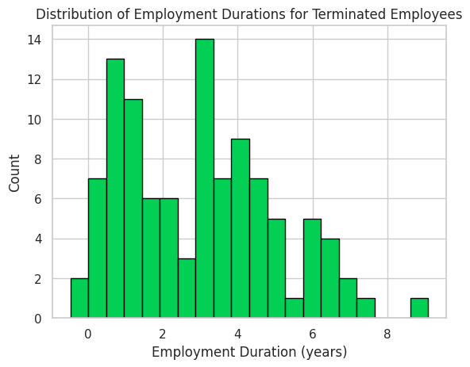
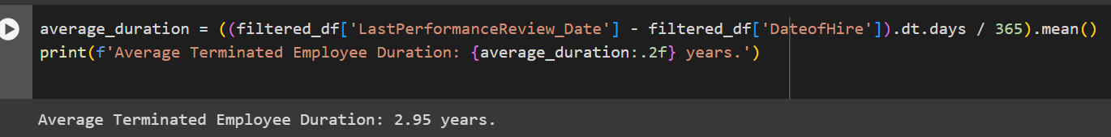
COMPANY DEMOGRAPHICS
EMPLOYEE STATUS
From the difference between the 'DateofHire' and 'LastPerformanceReview_Date' columns of terminated employees, we can visualize the approximate duration of their stay in the company.
Most ex-employees spend between 1 and 5 years. The highest number of them spent around 3.5 years. With an average duration of 2.95 years.

Slide 17
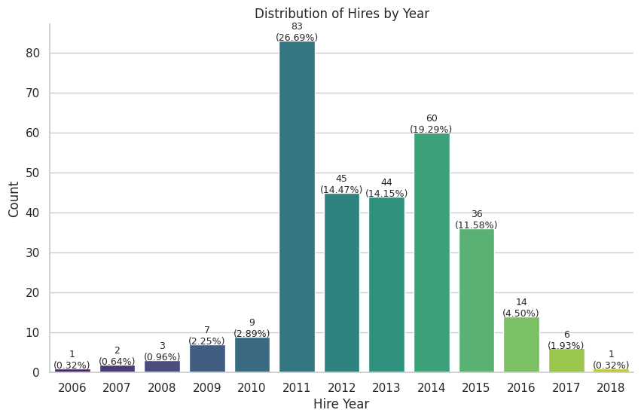
MORE COMPANY
HIGHLIGHTS
HIRING BY YEAR
From 2006 to 2011, the number of hires kept increasing each year reaching its peak in 2011 with 83 hires (9 times more hires than the past year!).
There was a decline in hires in 2012 and 2013, almost halving from the peak. Then it rose again to 60 hires (19.3%) in 2014, but a consistent decline followed, culminating in only 1 hire in 2018.

Slide 18
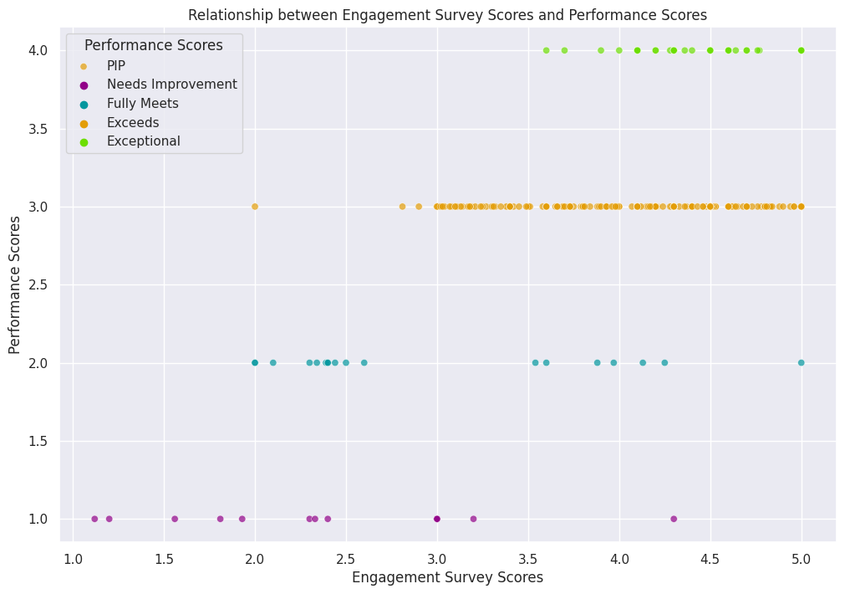
MORE COMPANY
HIGHLIGHTS
PERFORMANCE
The scatter plot shows there is a positive correlation between engagement survey scores and performance scores.
As the engagement survey scores increase, performance scores also tend to increase.

Slide 19
SUMMARY
After Visualizing the data we found that:
The company's workforce is predominantly in production, with notable variations in salary and satisfaction across departments.
The age distribution centers around 30-50. American citizenship is dominant and concentrated in Massachusetts. Female representation is higher, but a gender pay gap is observed, potentially influenced by departmental distribution. LinkedIn and Indeed are the source of 54.4% of the employees.
The majority of employees are still active. Terminated employees cite diverse reasons, and their average tenure is approximately 3 years. Hiring peaked in 2011, and positive correlations emerge between engagement survey scores and performance, underlining their interconnectedness.

Slide 20

THANK YOU!
By Anass El Aqli

